Slide 1
Project Moonshot (soscare.sg)
Additional Brands: Bonjela & Senokot

Slide 2
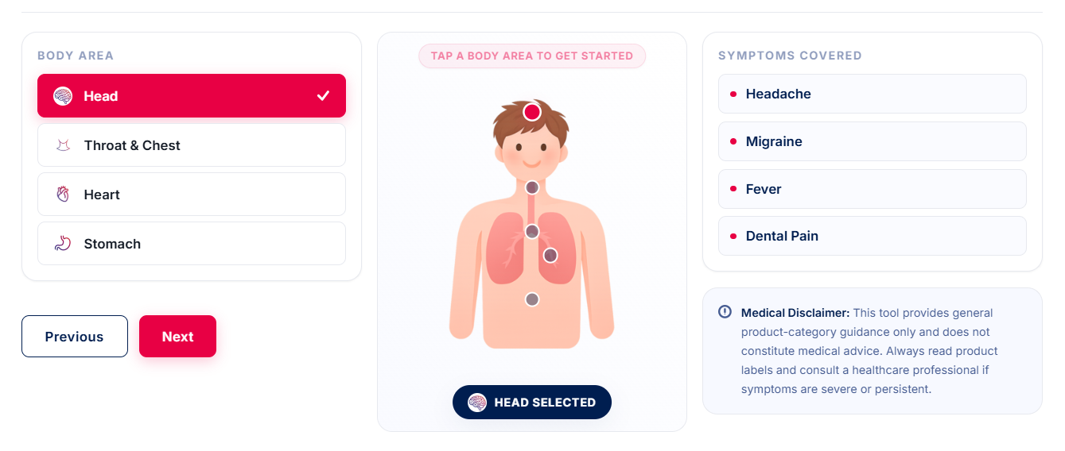
ADDITIONAL: BONJELA
To add:
BODY AREA
Mouth
SYMPTOMS COVERED
Mouth ulcers
Denture sore spots
Cold sores
Teething

Slide 3
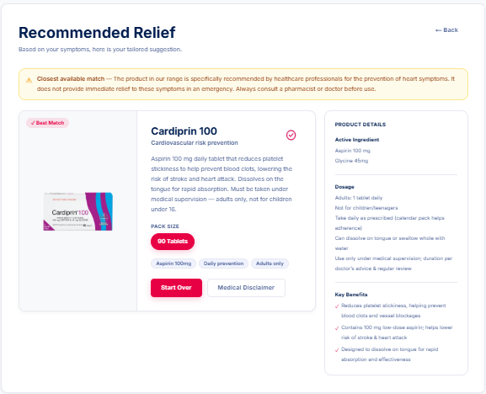
ADDITIONAL: BONJELA
Follow like Cardiprin – refer to product brief for more information on Bonjela
Closest available match — The product in our range is a fast acting gel for teething and mouth ulcers. It does not provide immediate relief to these symptoms in an emergency.

Slide 4
ADDITIONAL: SENOKOT
To add:
BODY AREA
Bowel
SYMPTOMS COVERED
Constipation

Slide 5
ADDITIONAL: SENOKOT
Follow like Cardiprin – refer to product brief for more information on Senokot
Closest available match — The product in our range specifically for relief of occasional constipation. It does not provide immediate relief to these symptoms in an emergency. Always consult a pharmacist or doctor before use.

